Slide 1
El Clásico de Reddit
Bárça vs. Real Madrid
By Christopher Williams
20 December 2018

Slide 2
Data Science Problem
Use NLP models to predict if certain comments / submissions come from one Subreddit or the other
Subreddit’s
/r/Barca
/r/realmadrid
The Data Collection Process
2834 from Barca
2747 from realmadrid

Slide 3
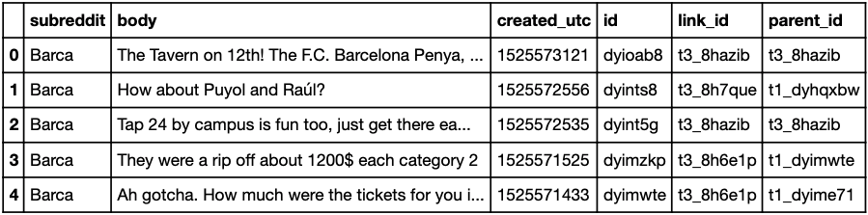
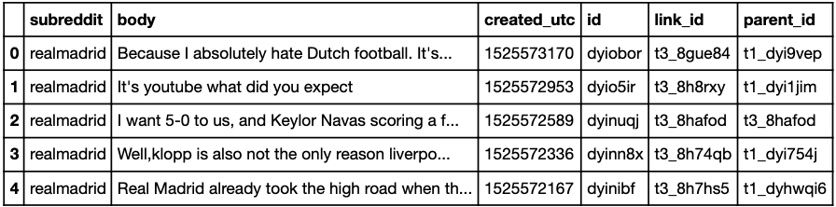
Examples of Subreddits’ Data

Slide 4
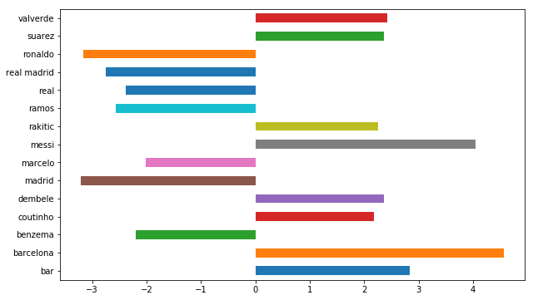
Features with Players / Teams

Slide 5
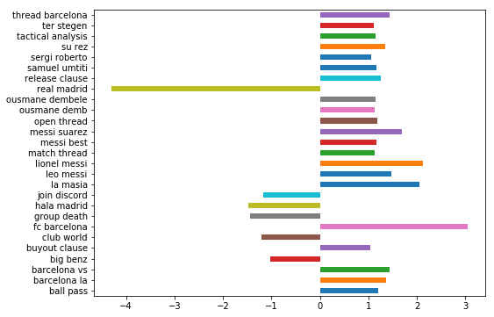
2 grams with Players / Teams

Slide 6
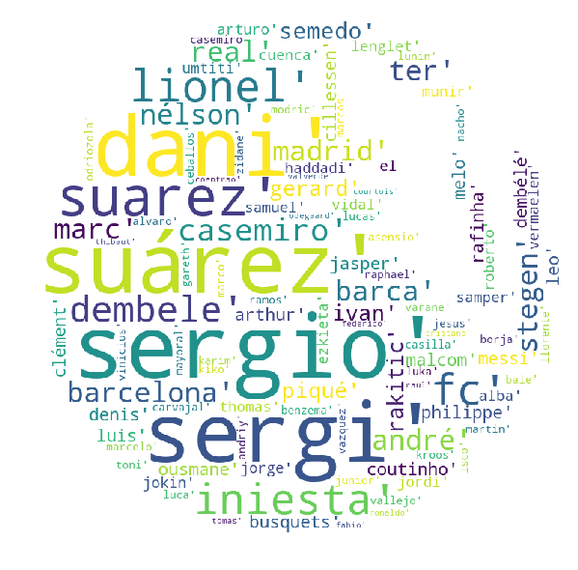
Stop Words:
Took Out Players Names to see performance of models
109 additional stop words along with the sklearn ones

Slide 7
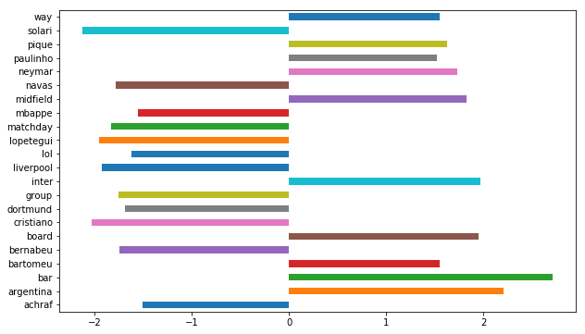
Without Players / Teams

Slide 8
The Models
TfidfVectorizer
LogisticRegression
RandomForestClassifier
ExtraTreesClassifier

Slide 9
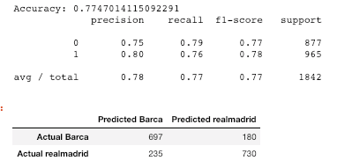
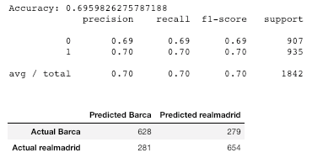
TfidfVectorizer and LogisticReg
TfidfVectorizer - With players names
Tfidf training score 0.926
Tfidf testing score started at 0.696 accuracy
With LogReg in GridSearch with ngrams as (1,3) improved to 0.774 accuracy score
With Players Names Without Names

Slide 10
Forest and Trees
Without or With Player & Team stop words
RandomForestClassifier
Best cv scores:
Keeping stop words in model, Train: 0.732 | Test: 0.699
Taking stop words out of model, Train: 0.655 |Test: 0.608
ExtraTreesClassifier
Best cv scores:
Keeping stop words in model, Train: 0.743 | Test: 0.699
Taking stop words out of model, Train: 0.664 |Test: 0.604

Slide 11
Random Forest
With Player’s & Clubs Names
Grid Search CV best score: 0.766
Best Params: {'max_depth': None, 'max_features': 'auto', 'n_estimators': 43}
Without Player’s & Clubs Names
Grid Search CV best score: 0.685
Best Params: {'max_depth': None, 'max_features': 'log2', 'n_estimators': 45}

Slide 12
Conclusions & Takeaways
Top feature is clearly players names
Take the names out, accuracy score drops substantially
To improve:
Gridsearch over more model parameters
More ngram features (3,6)
Put in coaches as stop words

